Slide 1
A Survey of Calculus

Slide 2
Slopes and Derivatives

Slide 3
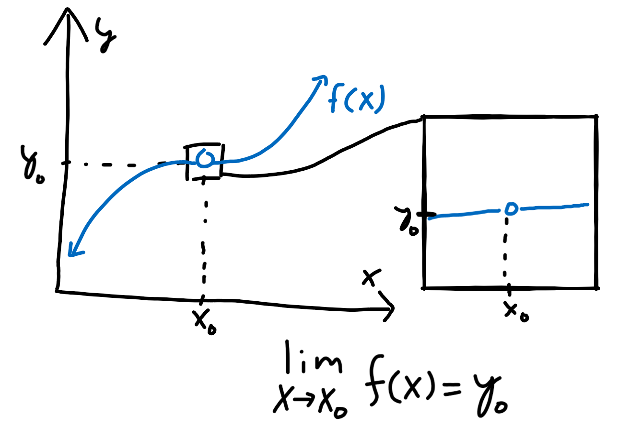
Limits
Let’s take a graph and remove a point from it.
How do we know which point we removed?
We can zoom in and see what the values of nearby points are and deduce that the removed point should be “very close” to the nearby points.
More concretely: we approach the point from both sides of the graph and see the trend very near, but not at, a particular point.
This is the idea behind taking a “limit” of a function.

Slide 4
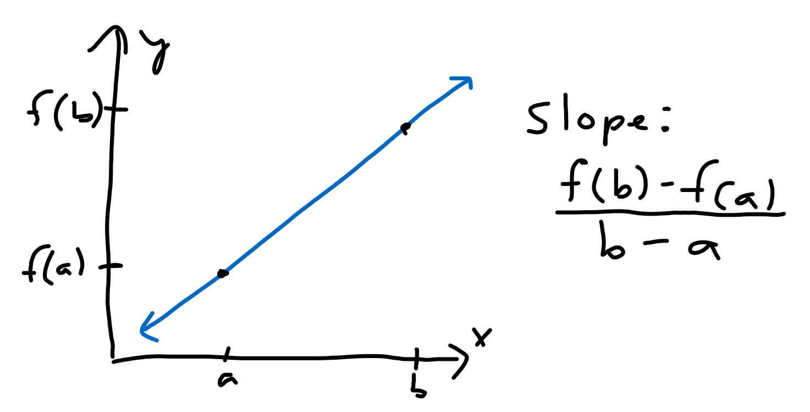
Slopes
We can calculate the “slope” of a line by taking the rise (change in y coordinate) and dividing it by the run (change in x coordinate).
For a line of the form y = f(x), the slope from a point x = a to x = b can be written as the fraction [f(b) - f(a)]/[b - a].

Slide 5
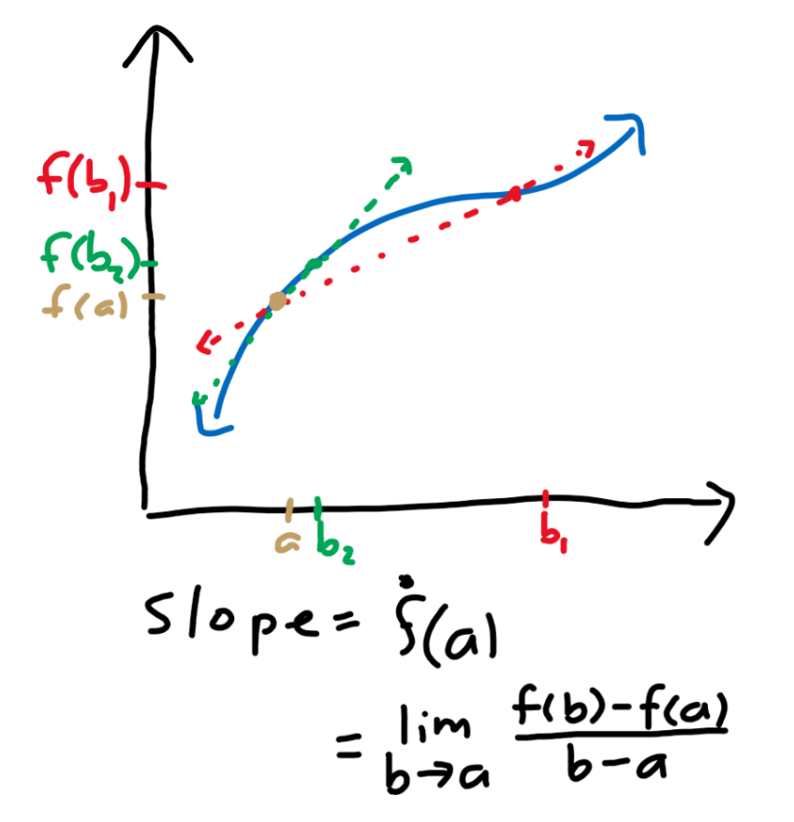
Derivatives
What about the slope for a non-linear curve?
We can approximate the slope at a certain point “a” as the slope of the line that passes through “a” and a nearby point “b.”
As b gets closer to a, our approximation gets better.
If we use our slope formula and take the limit as b approaches a, we get the slope of the curve at a point a.
We call the slope at a the value of the “derivative” of the curve at the point a.
We can denote the derivative of a function f at a point a to be f’(a).

Slide 6
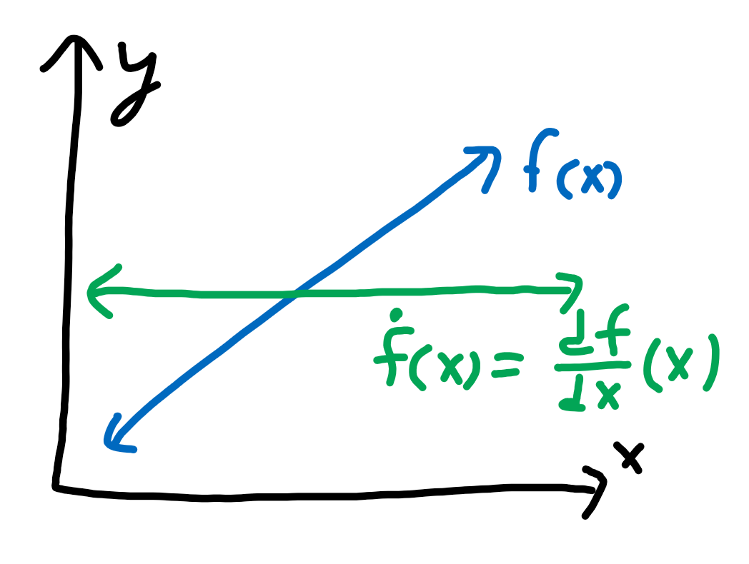
Derivatives as a function
We can plot the value of the derivative at every point to get the derivative as a function, which we denote as dy/dx where d represents a small change in.
Thus, dy/dx represents a small change in y divided by a small change in x, which is rise over run at a very small scale.

Slide 7
Areas and Integrals

Slide 8
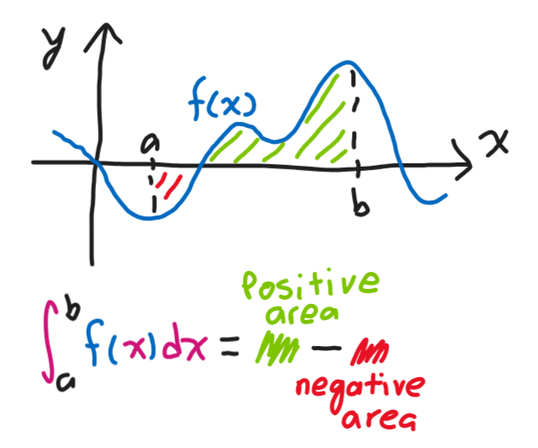
Areas Underneath Curves
The area “underneath” a curve is the area above the x-axis and below the curve.
If the curve is above the x-axis, this area is positive.
If the curve is below the x-axis, this area is negative.
We can define an integral from x=a to x=b to be the area underneath the curve on the interval [a, b].
We denote the integral of a function f(x) from x=a to x=b as ∫_{a}^{b} f(x)dx.

Slide 9
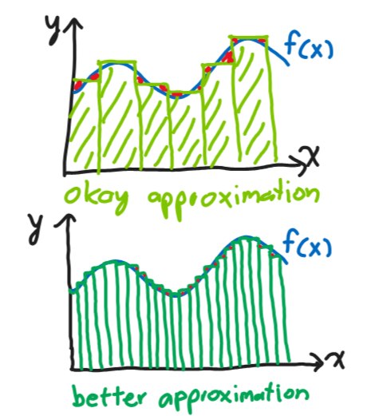
Riemann Summation
We can approximate the area under a curve using rectangles.
Line up a bunch of rectangles side-by-side. Make the height of the rectangle centered at x to be f(x).
The thinner we make our rectangles, the better this approximation becomes.
Taking the limit as the width of the rectangles go to zero gives the area exactly. This is one way to define an integral.

Slide 10
Fundamental Theorem of Calculus

Slide 11
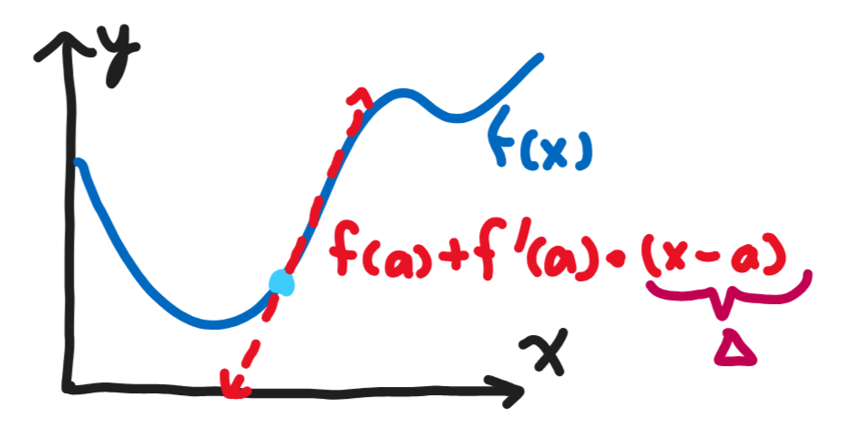
Linear Approximation
Given a function f(x), we can approximate f(x + Δ) for some small Δ to be f(x) + f’(x) * Δ.
Thus, we can approximate f(x + Δ) - f(x) as f’(x) * Δ.
Taking the limit as Δ → 0 makes this approximation exact.

Slide 12
Fundamental Theorem of Calculus
Consider some function f(x). We can write f(b) - f(a) as a sum [f(b) - f(b - Δ)] + [f(b - Δ) - f(b - 2Δ)] + … + [f(a + 2Δ) - f(a + Δ)] + [f(a + Δ) - f(a)].
Then, take a linear approximation of each term to get [f’(b) * Δ] + [f’(b - Δ) * Δ] + … + [f’(a + 2Δ) * Δ] + [f’(a + Δ) * Δ].
This is the same as Riemann summing rectangles of width Δ to approximate the area of f’(x) from x=a to x=b.
Taking the limit as Δ → 0 gives us our integral ∫_{a}^{b} f’(x)dx. Thus, f(b) - f(a) = ∫_{a}^{b} f’(x)dx. This is one statement of the fundamental theorem of calculus.
The other statement is d/dx ∫_{a}^{x} f(t)dt = f(x). In other words, differentiation and integration invert each other.

Slide 13
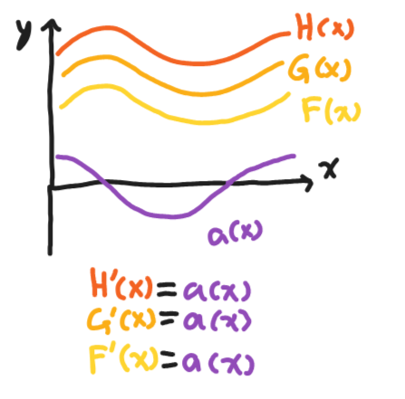
Indefinite Integrals
We can define an indefinite integral to be the opposite of a derivative.
In other words, the indefinite integral F(x) of a function f(x) is defined such that F’(x) = f(x).
However, there are multiple such F(x) such that F’(x) = f(x). Thus, we add a “+C” term to indicate that we can add any arbitrary constant to F(x) and F’(x) will still equal f(x).

